Slide 1
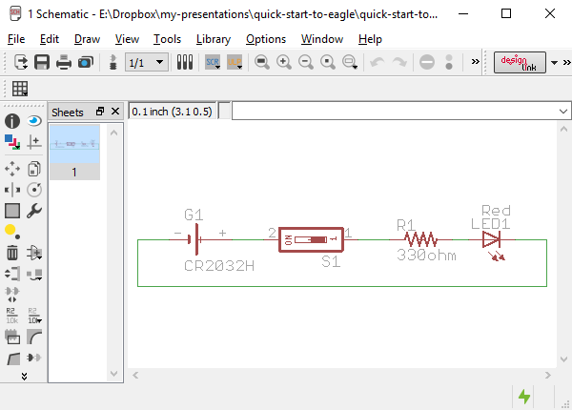
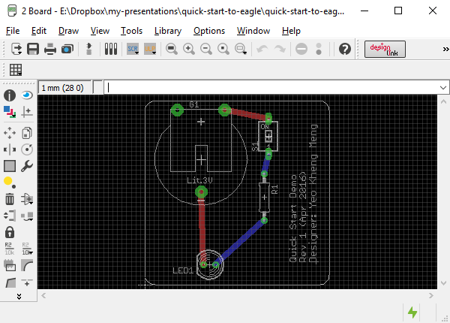
Quick Start to Cadsoft Eagle
By: Yeo Kheng Meng (yeokm1@gmail.com)
https://github.com/yeokm1/quick-start-to-eagle
Hackware v1.7 (27 April 2016)

Slide 2
About Eagle
Since 1988 - present
Made by CadSoft Computer GmbH
Commonly used by makers
Adafruit + Sparkfun + Arduino
Extensive library support
Free “Lite” version
Non-commercial use
Max 2 copper layers
100 x 80 mm board size
To exceed limitations: http://www.cadsoftusa.com/eagle-pricing/
Multi-platform: Windows, Mac, Linux
Saved as XML (ASCII) files, great for version-control

Slide 3
PCB Design/Manufacturing Workflow
1. Establish project requirements
2. Acquire parts and prototype
3. Design your PCB schematic
4. Run electrical rule check (ERC).
5. Design board: place parts & wiring
6. Setup/run design rule check (DRC)
7. Do 3D rendering
8. Use CAM file to generate Gerbers
9. Zip up relevant Gerber files
10. Set PCB fabrication settings
11. Write out bill of materials (BOM)
12. PCB Assembly

Slide 4
1. Establish project requirements
1. Establish project requirements
Switch ON/OFF LED
Powered from coin cell
2. Acquire parts and prototype
3. Design your PCB schematic
4. Run electrical rule check (ERC).
5. Design board: place parts & wiring
6. Setup/run design rule check (DRC)
7. Do 3D rendering
8. Use CAM file to generate Gerbers
9. Zip up relevant Gerber files
10. Set PCB fabrication settings
11. Write out bill of materials (BOM)
12. PCB Assembly

Slide 5
2. Acquire parts and prototype
1. Establish project requirements
5mm red LED
330ohm resistor
Switch
CR2032 battery holder
2. Acquire parts and prototype
3. Design your PCB schematic
4. Run electrical rule check (ERC).
5. Design board: place parts & wiring
6. Setup/run design rule check (DRC)
7. Do 3D rendering
8. Use CAM file to generate Gerbers
9. Zip up relevant Gerber files
10. Set PCB fabrication settings
11. Write out bill of materials (BOM)
12. PCB Assembly

Slide 6
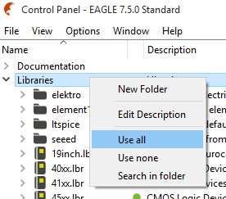
3a. Design your PCB Schematic
Schematic defines connections between components
Open Eagle and add external libraries
Import libraries. (Not shown)
Locate the libraries folder I have provided
Drag-and-drop the *.lbr files one by one into Eagle Control Panel Libraries folder
Right-Click on Libraries Folder -> Use all
1. Establish project requirements
2. Acquire parts and prototype
3. Design your PCB schematic
4. Run electrical rule check (ERC).
5. Design board: place parts & wiring
6. Setup/run design rule check (DRC)
7. Do 3D rendering
8. Use CAM file to generate Gerbers
9. Zip up relevant Gerber files
10. Set PCB fabrication settings
11. Write out bill of materials (BOM)
12. PCB Assembly

Slide 7
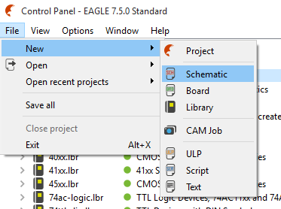
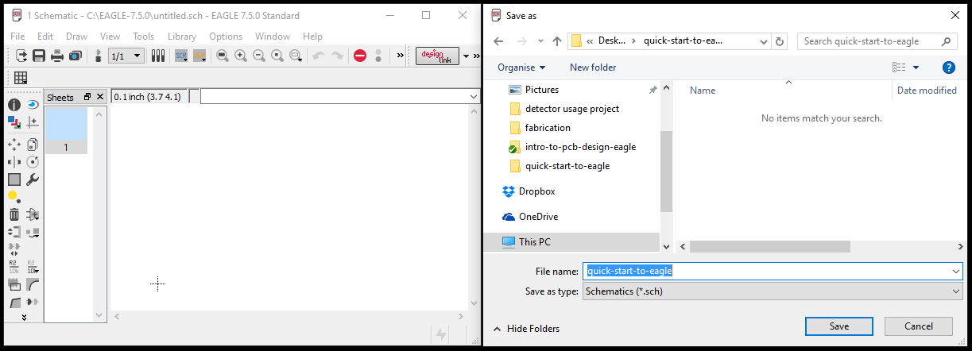
3b. Design your PCB Schematic
Create and save schematic file (part and connection layout)
Create a folder on desktop “quick-start-to-eagle”
Create new schematic *.sch: File -> New -> Schematic
Save schematic
1. Establish project requirements
2. Acquire parts and prototype
3. Design your PCB schematic
4. Run electrical rule check (ERC).
5. Design board: place parts & wiring
6. Setup/run design rule check (DRC)
7. Do 3D rendering
8. Use CAM file to generate Gerbers
9. Zip up relevant Gerber files
10. Set PCB fabrication settings
11. Write out bill of materials (BOM)
12. PCB Assembly

Slide 8

3c. Design your PCB Schematic
Add components
CR2032 battery holder
battery -> CR2032H
Switch
switch-dil -> SD4-01
Resistor
resistor -> R-US_ -> R-US_0207/10
2mm diameter, 7mm length, 10mm lead length
5mm Red LED
led -> LED -> LED5MM
1. Establish project requirements
2. Acquire parts and prototype
3. Design your PCB schematic
4. Run electrical rule check (ERC).
5. Design board: place parts & wiring
6. Setup/run design rule check (DRC)
7. Do 3D rendering
8. Use CAM file to generate Gerbers
9. Zip up relevant Gerber files
10. Set PCB fabrication settings
11. Write out bill of materials (BOM)
12. PCB Assembly

Slide 9


3d. Design your PCB Schematic
Maneuvering and layout
Zoom with scroll-wheel
Click-drag middle mouse button to move sheet
Rotate components
Choose Move command
Click component “+” sign then right-click
Define component value if needed
Right-click component -> Value
Delete object with trash icon
Wiring
Use “Net” command
Link components together
Hover mouse just overlapping the contacts
Press “Alt” increased precision key if wire cannot overlap
Left-click to set and also to change direction
1. Establish project requirements
2. Acquire parts and prototype
3. Design your PCB schematic
4. Run electrical rule check (ERC).
5. Design board: place parts & wiring
6. Setup/run design rule check (DRC)
7. Do 3D rendering
8. Use CAM file to generate Gerbers
9. Zip up relevant Gerber files
10. Set PCB fabrication settings
11. Write out bill of materials (BOM)
12. PCB Assembly

Slide 10
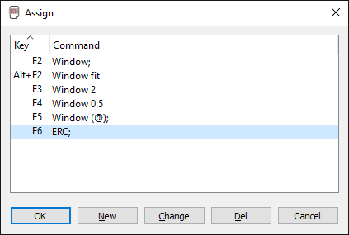

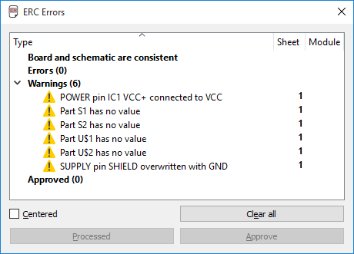
4. Run electrical check (ERC)
Tests if your wiring has been done properly
Not foolproof but usually good enough to detect weird or missing connections
Run ERC regularly, assign to shortcut key. Options -> Assign
Correct ALL errors
Inspect all warnings
Correct if needed
Ignore if you are sure
I discourage approving
1. Establish project requirements
2. Acquire parts and prototype
3. Design your PCB schematic
4. Run electrical rule check (ERC).
5. Design board: place parts & wiring
6. Setup/run design rule check (DRC)
7. Do 3D rendering
8. Use CAM file to generate Gerbers
9. Zip up relevant Gerber files
10. Set PCB fabrication settings
11. Write out bill of materials (BOM)
12. PCB Assembly

Slide 11
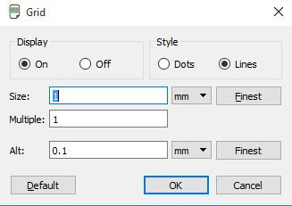
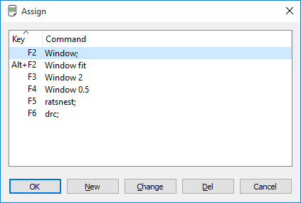
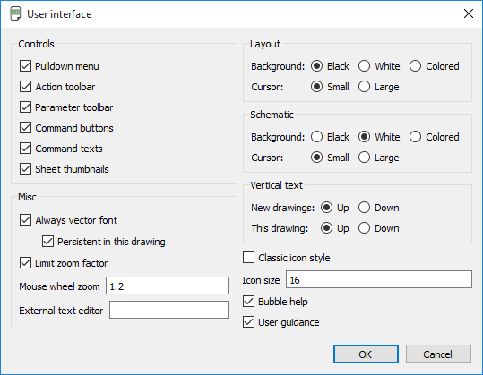
5a. Design board: place parts & wiring
Create and save board file (board layout)
File -> Switch to board
Initial board configuration
Adjust grid settings to mm as shown.
View -> Grid
Create keyboard shortcuts for commonly used functions.
Options -> Assign
Not case-sensitive
End with “;”
Enable Vector font
Options -> User Interface
Tick Always vector font
Tick Persistent
1. Establish project requirements
2. Acquire parts and prototype
3. Design your PCB schematic
4. Run electrical rule check (ERC).
5. Design board: place parts & wiring
6. Setup/run design rule check (DRC)
7. Do 3D rendering
8. Use CAM file to generate Gerbers
CAM Processor can only convert vector fonts into Gerbers properly.
See: http://www.cadsoftusa.com/training-service/faq/#c95
9. Zip up relevant Gerber files
10. Set PCB fabrication settings
11. Write out bill of materials (BOM)
12. PCB Assembly

Slide 12
6a. Setup/run design rule check (DRC)
Design rules provided by fabricator to check if your PCB adheres to requirements
Download PCB fabricator DRU, in this case Elecrow
http://www.elecrow.com/10pcs-2-layer-pcb-p-1175.html
http://www.elecrow.com/download/Elecrow_PCB_eagle_rule.zip
1. Establish project requirements
2. Acquire parts and prototype
3. Design your PCB schematic
4. Run electrical rule check (ERC).
5. Design board: place parts & wiring
6. Setup/run design rule check (DRC)
7. Do 3D rendering
8. Use CAM file to generate Gerbers
9. Zip up relevant Gerber files
10. Set PCB fabrication settings
11. Write out bill of materials (BOM)
12. PCB Assembly
*I use Elecrow as a learning example here but it does not mean I endorse this company in any way.

Slide 13

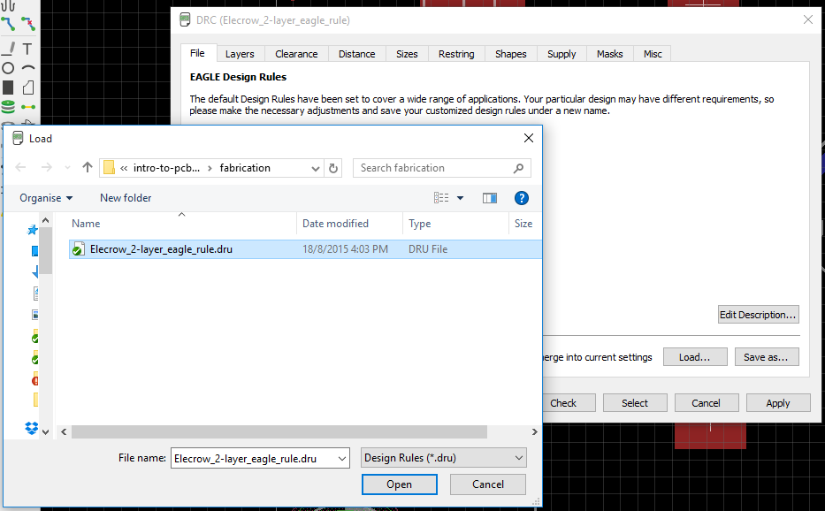
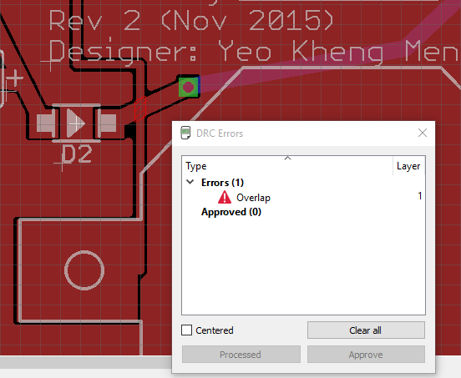
6b. Setup/run design rule check (DRC)
Load DRU file just once
Press “check” to check your board or use keyboard shortcut
Rectify all errors
1. Establish project requirements
2. Acquire parts and prototype
3. Design your PCB schematic
4. Run electrical rule check (ERC).
5. Design board: place parts & wiring
6. Setup/run design rule check (DRC)
7. Do 3D rendering
8. Use CAM file to generate Gerbers
9. Zip up relevant Gerber files
10. Set PCB fabrication settings
11. Write out bill of materials (BOM)
12. PCB Assembly

Slide 14
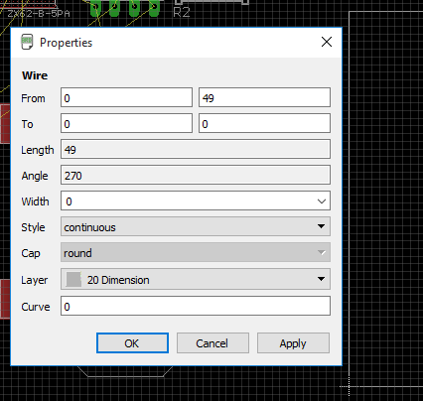
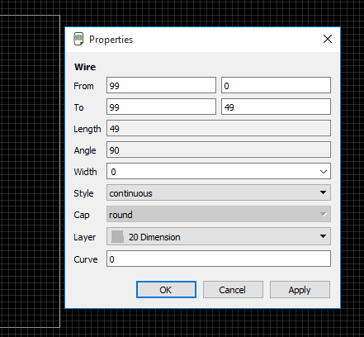
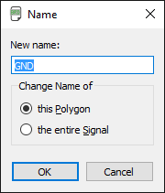

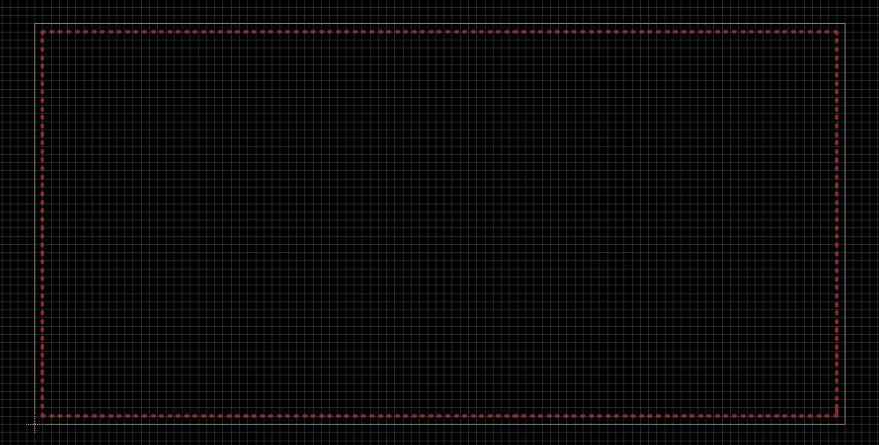
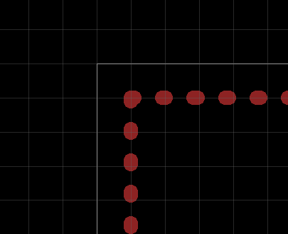
5b. Design board: place parts & wiring
General board steps
Adjust board size to your requirements eg: 99mm x 49mm (check fabricator price point)
Place ground/power plane on Top layer using polygon function. 1mm away from edges to ease future resizing. Set polygon name.
1. Establish project requirements
2. Acquire parts and prototype
3. Design your PCB schematic
4. Run electrical rule check (ERC).
5. Design board: place parts & wiring
6. Setup/run design rule check (DRC)
7. Do 3D rendering
8. Use CAM file to generate Gerbers
9. Zip up relevant Gerber files
10. Set PCB fabrication settings
11. Write out bill of materials (BOM)
12. PCB Assembly

Slide 15
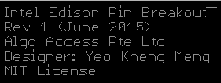
5c. Design board: place parts & wiring
General board steps
Component placement order
Place mounting holes
User-facing components, like USB connectors, switches and LEDs
Large components
Everything else
Wiring order (Trace width usually the size of the solder pads)
Wire high-speed connections, avoid using vias
Wire power connections with wider traces
Wire everything else
Execute DRC check and rectify if needed
Silkscreen placement order (don’t overlap with any holes/vias/parts)
Smash component & adjust part designators if required to minimise confusion
Add descriptive text to certain areas to silkscreen
Add PCB description/revision
Miter corners
Make sure Ratsnest gives “Nothing to do”
Tips
Execute Ratsnest to recalculate remaining airwires’ position as much as possible after every operation
Run DRC after you make every change to catch problems earlier
Wire at 45 degree angles to reduce signal reflection
1. Establish project requirements
2. Acquire parts and prototype
3. Design your PCB schematic
4. Run electrical rule check (ERC).
5. Design board: place parts & wiring
6. Setup/run design rule check (DRC)
7. Do 3D rendering
8. Use CAM file to generate Gerbers
9. Zip up relevant Gerber files
10. Set PCB fabrication settings
11. Write out bill of materials (BOM)
12. PCB Assembly

Slide 16
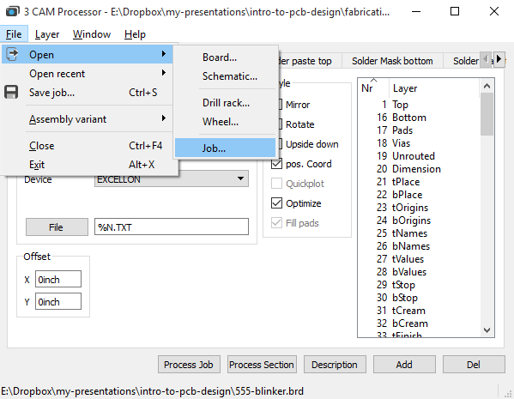
8. Use CAM file to generate Gerbers
Gerber files
2D vector format used by PCB fabricator to make PCBs for you
CAM file provided by fabricator to help you generate Gerber layer files
Download PCB fabricator’s CAM processor, in this case Elecrow
http://www.elecrow.com/10pcs-2-layer-pcb-p-1175.html
http://www.elecrow.com/download/Elecrow_Gerber_Generater_DrillAlign.zip
Use the correct CAM file according to number of layers like 2 layers
Open CAM Processor: File -> CAM Processor
Once in CAM Processor, load the CAM job as shown below
Once you are done, click “Process Job”
1. Establish project requirements
2. Acquire parts and prototype
3. Design your PCB schematic
4. Run electrical rule check (ERC).
5. Design board: place parts & wiring
6. Setup/run design rule check (DRC)
7. Do 3D rendering
8. Use CAM file to generate Gerbers
9. Zip up relevant Gerber files
10. Set PCB fabrication settings
11. Write out bill of materials (BOM)
12. PCB Assembly

Slide 17
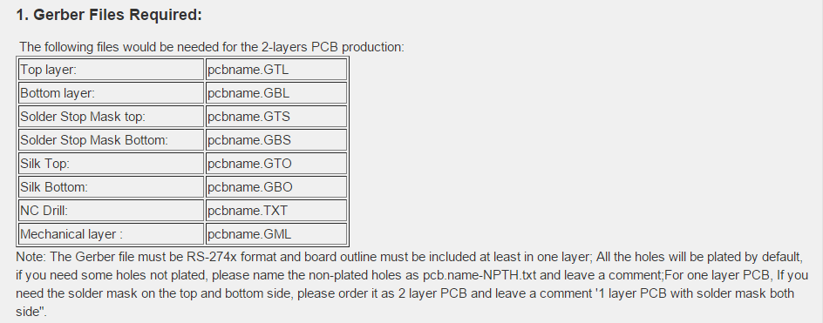
9. Zip up relevant Gerber files
See what files are required by the PCB fabricator
Elecrow’s requirements:
Go to saved folder and zip up the required files
Rightfully you should inspect your Gerber files for potential mistakes using software/websites like:
GR-Prevue: http://www.graphicode.com/GC-Prevue_Gerber_Viewer
http://circuitpeople.com/
http://mayhewlabs.com/webGerber/
But so far I don’t have any problems so I usually skip the Gerber file check step
1. Establish project requirements
2. Acquire parts and prototype
3. Design your PCB schematic
4. Run electrical rule check (ERC).
5. Design board: place parts & wiring
6. Setup/run design rule check (DRC)
7. Do 3D rendering
8. Use CAM file to generate Gerbers
9. Zip up relevant Gerber files
10. Set PCB fabrication settings
11. Write out bill of materials (BOM)
12. PCB Assembly

Slide 18
Questions?

